Slide 1


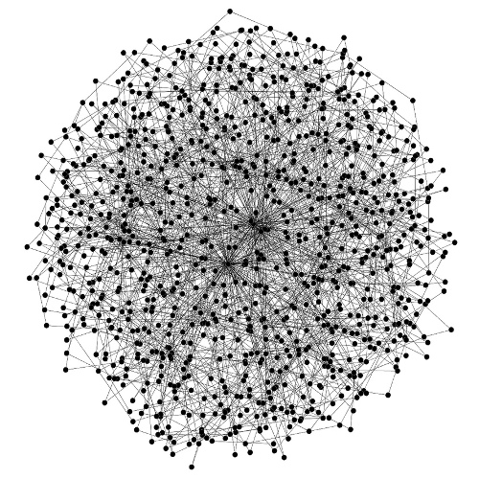

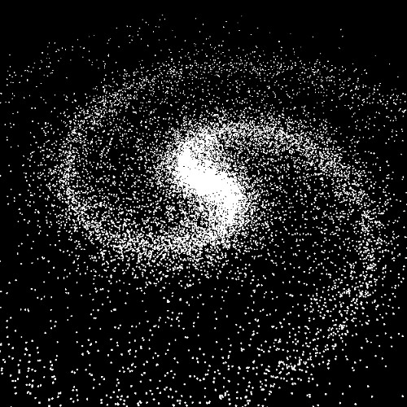
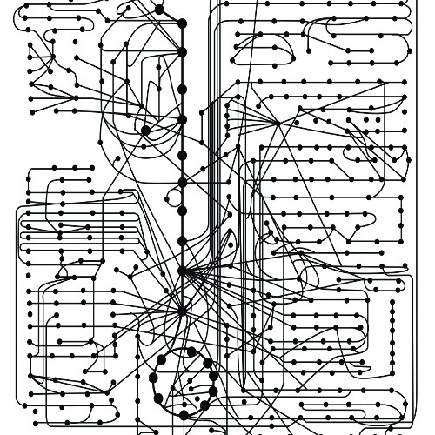
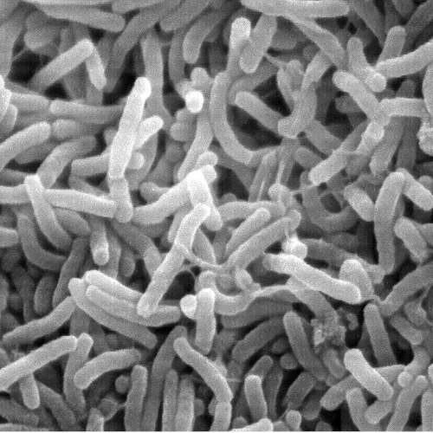
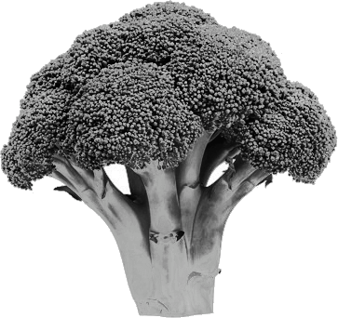

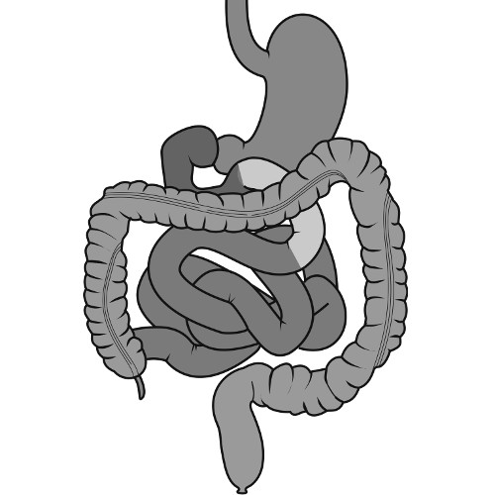
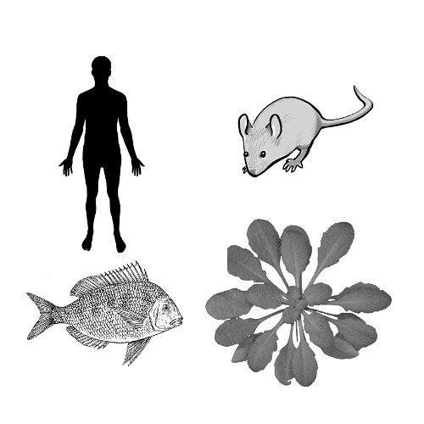
Application of biological priors to improve integration of multi-omics data sets
Wiktor Jurkowski

Slide 2
Introduction to biological networks
Part I

Slide 3
Network types
Description and definition of networks depending on type of
Molecules: DNA, RNA, proteins, chemicals
Relations: molecular binding, chemical reactions, logical associations
Representation: graph, hypergraph

Slide 5
graph
hypergraph

Slide 6
Network processing and analysis
Network reconstruction
Network modularization
Network dynamics
Text mining
Expression data
Knowledge-based contextualization
Hubs detection
Signaling paths
Active
Differential
Conserved
Attractors
Steady states

Slide 7
Popular Tools to integrate data on networks
Part II

Slide 8
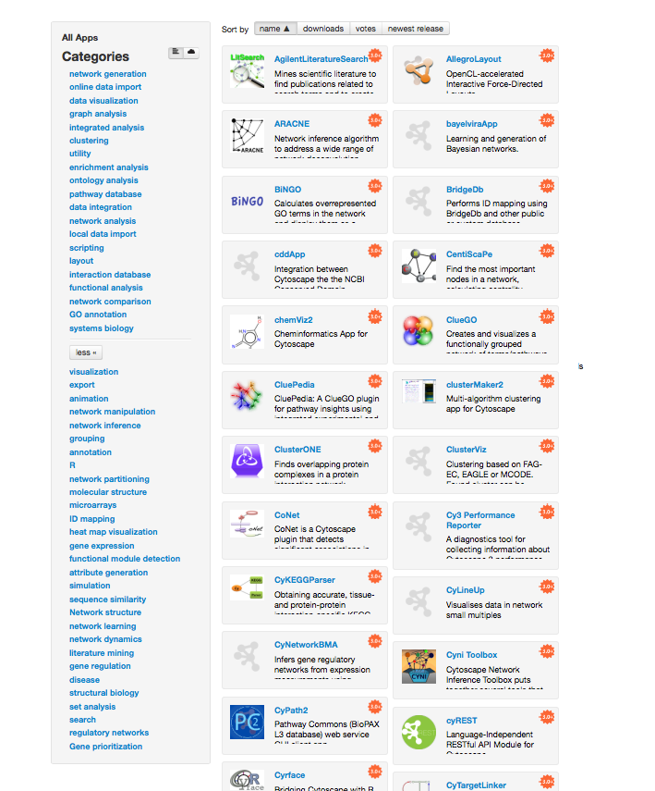
Cytoscape
Network construction, analysis and visualization environment
Dozens of plugins for network-related analysis
Network reconstruction: data driven, text mining, bayesian
Functional analysis: enrichment, GO, pathway analysis
Clustering and modularization
Graph analysis
Utility (formats, identifiers translation)

Slide 9
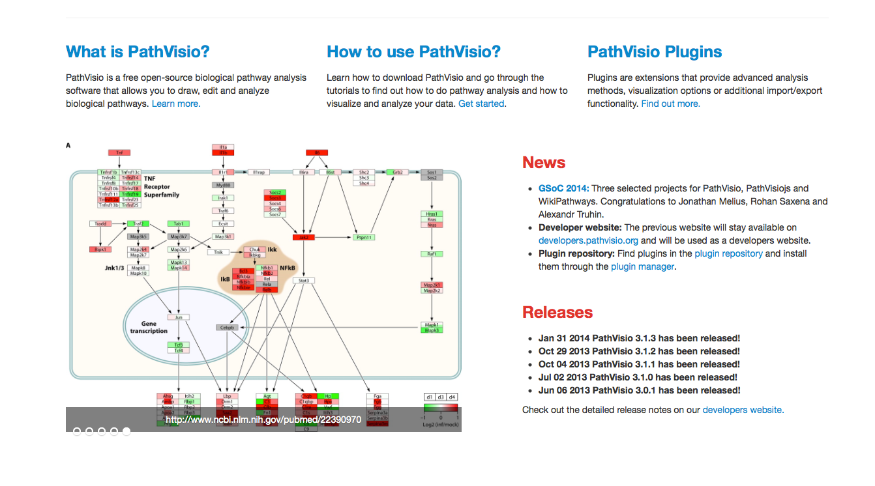
PathVisio
Free open-source pathway analysis and drawing software
Visualize your own experimental data
Find relevant pathways that are over-represented in your data set
Additional features available as plugins
Currently ~20 plugins available
Export/import, GO analysis

Slide 10
Others
Igraph (python, R)
Network analysis on Galaxy
Encore: Construction, analysis, and visualization of gene-gene interaction networks for sequencing data (Lareau CA et al.)
SBMLsqueezer: Generate kinetic rate equations for biochemical networks
PredPharmTox: Implements the QuantMap tools for grouping chemicals by biological activity (Schaal et al.)

Slide 11
NETWORK ASSISTED BIOMARKER DISCOVERY
Part III

Slide 12
Supervised classification procedure of using biomarker signatures for outcome prediction
( a )
A subset of features – biomarker signature is selected from the given experimental data e.g. samples of patients which are either healthy or diseased.
The measured values of the signature serve as an input to train a classifier.
( b )
The trained classifier model can predict the class labels of new observations
Disease status predicted from measurement of a patient with unknown health status
Struntz, 2016, Meth. Mol. Biol.

Slide 13
Limitations and Challenges of Biomarker Discovery
Problem: low reproducibility and the limited biological interpretability of candidate biomarker signatures identified from high-throughput data
Feature stability - similarity of ranked lists obtained either by applying the same feature selection method to slightly modified versions of the underlying data set (e.g. using different subsamples of the original data set) or by applying different feature selection methods on the same data set (Boulesteix A-L, Slawski M, 2009, Brief Bioinform)
High stability of features with respect to sampling variations is a good indicator for biomarker reproducibility
Markers which are tolerant against variations within data have a higher chance of having a high discriminatory power for experimental data from different studies generated in different laboratories

Slide 14
Limitations and Challenges of Biomarker Discovery
Sources of instability (He Z, Yu W, 2010, Comput Biol Chem)
multiple true markers, all allowing an equally accurate outcome prediction
small number of observations compared to the extremely high number of measured features in high-dimensional data can lead to instability
algorithms that are primarily designed to select feature subsets providing the best prediction accuracy and do not explicitly attach importance to the stability
By ignoring potential dependencies between the features, the selected signature may contain redundant information which impedes a synergistic improvement of the discriminatory power

Slide 15
Application of biological priors
Stability can be improved, through dimensionality reduction, by applying biological priors (Cun Y, Fröhlich H, 2012, Biology)
Network and data-centric approaches for application of biological priors
Network centric: feature selection, incorporating prior information about pathways and molecular networks, and the supervised or unsupervised classification are uncoupled processes
Pathway Activity Analysis: inferring activity scores for specific pathways which are subsequently used for classification
Differential Network Analysis: identification of subnetworks or modules that serve as biomarker signatures

Slide 16
Pathway Activity Analysis
High throughput data
Canonical pathways
Use pathways instead of genes
Pathway activity score

Slide 17
Overview approaches for PAA
Tool | Method | Resource | Pathway activity measure | Classification method
- | Guo, 2005 | GO | Mean, median | Decision tree
- | Tomfohr (2005); Liu (2012) | KEGG, Biocarta; MsigDB | PCA (weighted sum of normalised expression) | -; probit regression; SVM
- | Lee, 2008; Yang, 2012 | MsigDB | Expression Z-score of condition-responsive genes | Logistic regression, SVM
- | Su, 2009 | MsigDB | Log-likelihood | Logistic regression
PARADIGM | Vaske, 2010 | PID | Factor graph models | Unsupervised clustering
-; | Kim, 2012; Tarca, 2009 | MsigDB, KEGG | GSEA | Hierarchical SVM
Pathway Studio + bsnea | Pyatnitskiy, 2014 | ResNet | SNEA | Unsupervised clustering

Slide 18
PAA limitations
Incomplete pathways
Neglecting topology. The method is accounting for expression of genes within pathway but ignoring connectivity

Slide 19
Differential Network Analysis
Tool | Method | Resource | Network analysis | Biomarker selection
- | Chuang, 2007 | PPI | Greedy search of subnetwork | Permutation test (significant subnetworks)
- | Liu, 2012 | PPI: HPRD | Condition specific networks | Genes expressed in both conditions and in differential edges
- | Perumal, 2014 | GRN | Simulations of transitions between conditions | Genes in differentially expressed circuits
-; pathClass R package | Weng, 2011; Zhu 2009; Johannes, 2010 | PPI | Relation between expression values quantified by protein association | Difference of protein associations between networks; penalised SVM
DDN MATLAB toolbox | Zhang 2009; Tian 2014 | Any graph | Penalised linear regression for inference differential dependency network (a node given multiple parents) | Nodes in local significant subnetworks
GenPEN, MultiPEN | Vlassis, 2014; TroncosoRey (in prep.) | PPI; complex networks | Penalised logistic regression | Genes ranked by model weights

Slide 20
Exploring limits of network ­driven omics integration
n
Build prediction models to explain phenotypes e.g. health vs. disease
Standard models e.g. logistic regression require p < n
p
p >> n problem
Associations between genes and metabolites
ONION
Clustering the genetic data according to its functionality and application of statistics to integrate the omics data
MultiPEN
Solve a penalised logistic regression to identify connectedness and coordinated changes in the biological network
Different, better than single data sets?
Network connectivity vs. quality?

Slide 21
ONION: BIOMARKER DISCOVERY in sub-netwroks
Part IV

Slide 22
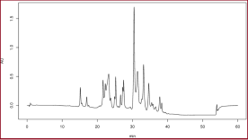
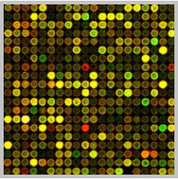
Integration of transcriptomics and metabolomics data
{
}
p>>n
Integrated pathways
+ Easy to implement enrichment analysis
Heterogeneity of pathway annotation
Bias towards biochemical reactions
Constrained Flux Balance
+ Precise calculation of mass balance
Depends on network consistency
Bias towards biochemical reactions
Bias towards well studied processes (with known kinetics)
Multivariate Statistics
+Associations between genes and metabolites
- Requires large data sets of multiple conditions (e.g. dietary regimes, age, sex etc.)

Slide 23
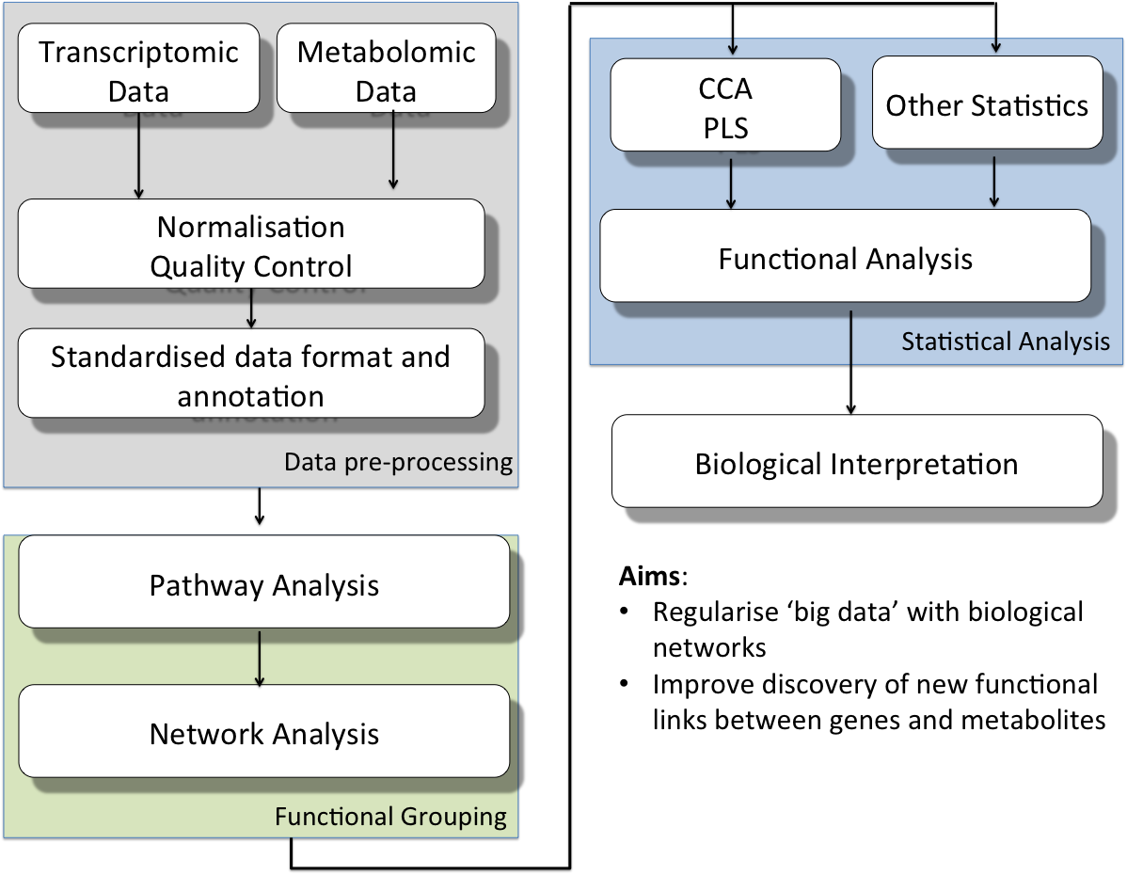


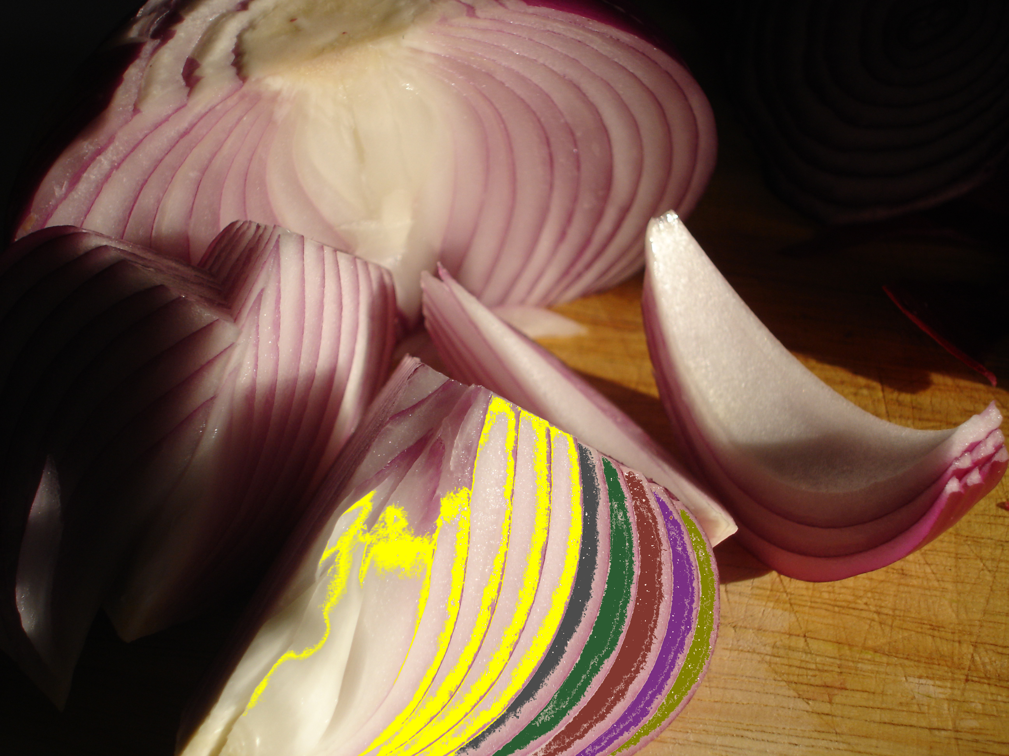
ONION: Network-guided multivariate analysis
ChEBI
Locally-low dimension
Piwowar M, Jurkowski W, PLoS One, 2015

Slide 24
Locally-low dimension
Small molecule clustering in ChEBI ontology and by fingerprints
Clusters centroids: subnetwork seeds
Genes/proteins in canonical pathways
Predicted and validated PPI Interactions
GROUPS
Current work
Bioconductor package
Improvement of MCS calculations
Gap filling in metabolic models
Notes:
Dassa

Slide 25

Comparison with randomized groups
4 groups vs. undivided data set
In both CCA and PLS results functional groups are significantly different than randomised groups one-sample t-test p<0.05
Notes:
Dassa

Slide 26
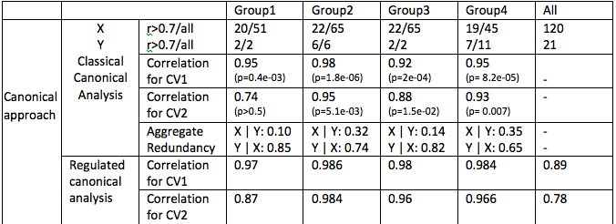
Groups vs. complete data
CCA of murine data. Canonical variables and p-values are calculated within functional groups (group 1-3), remaining variables (group 4) and for undivided data set. X – transcriptomics data; Y-lipidomics data; all – total number of variables; r0.7 – number variables after rejection of variables correlated on the 0.7 level
Notes:
Dassa

Slide 27
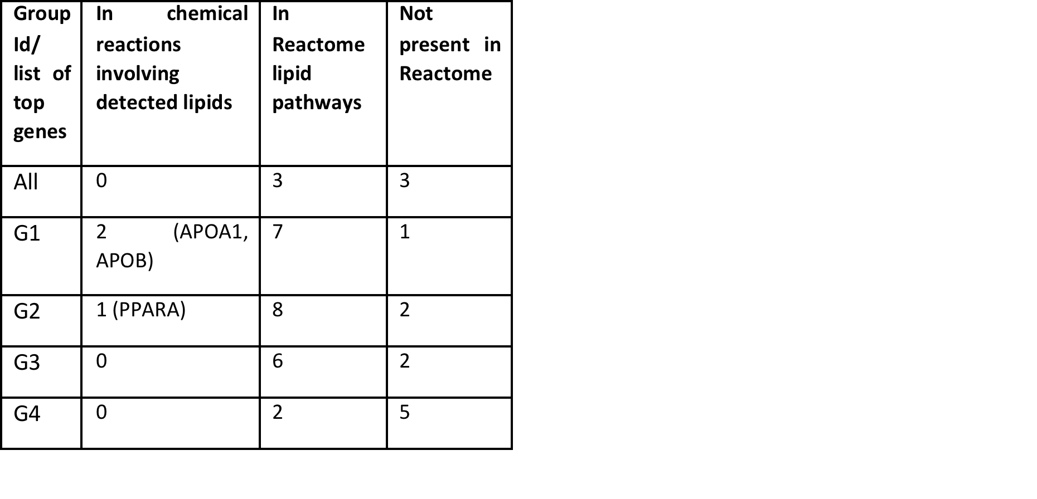
No significant pathways in not divided data set
Metabolism of lipids and lipoproteins
Defective CYP24A1 causes Hypercalcemia
GABA synthesis
Import of palmitoyl-CoA into the mitochondrial matrix
PPARA activates gene expression

Slide 28
ONION: BIOMARKER DISCOVERY in sub-netwroks
Part IV

Slide 29
Pairwise Elastic Net
The Pairwise Elastic Net, PEN, is an approach to regression regularisation that simultaneously performs automatic variable selection and continuous shrinkage.
PEN encourages the grouping of strongly correlated predictors based on a pairwise similarity measure.
Lorbert, A., Eis, D., Kostina, V., Blei, D. M., Ramadge, P. J. Proceedings of the 13th International Conference on Artificial Intelligence and Statistics (AISTATS 2010).

Slide 30
GenePEN
Analysis of network activity in complex disease
Convex optimisation problem
Where f(w,v) is the expected logistic loss:
And GenePEN penalty function is defined by:
Vlassis, N., Glaab, E., Stat. Appl. Genet. Mol. Biol. 2015

Slide 31

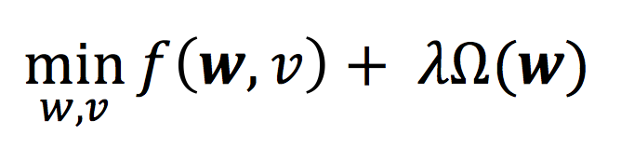
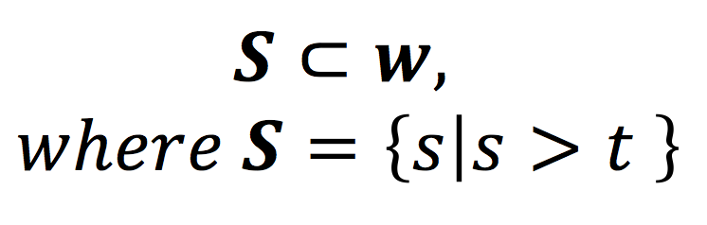
Exploring limits of network-driven omics integration
control
cases
metabolomics
transcriptomics
Samples
Omics Data
y₁
y₂
...
y_{n}
x_{1,1} . . . x_{1,p}
x_{2,1} . . . x_{2,p}
… . . . …
x_{n,1} . . . x_{n,p}
PPI Network
Biochemical and Signaling Pathway
Y =
X =
x_{1,1} . . . x_{1,p}
x_{2,1} . . . x_{2,p}
. . .
. . .
. . .
x_{p,1} . . . x_{p,p}
A =
Penalised Logistic Regression
Adjacency Matrix (for the biological network)
where p is the number of features,
n is the number of samples,
t is a threshold for the feature
selection
λ is a regularisation parameter
w is the list of learned weights
S is the list of selected weights
Feature Selection
Process
GenPEN, Vlassis 2015

Slide 32
Exploring limits of network-driven omics integration
Current work
Adapt the penalty function to better integrate different types of data
Compare rankings obtained using different input graphs (representing various interaction types and sources, e.g. PPI network and the Reactome Functional Interaction network)
Evaluate precision of the classifier
Functional analysis where the objective is the novelty and interpretability of detected associations
We use simulated and publicly available data sets that include transcriptomics and metabolomics from nutritional and diet intervention studies of obesity and diabetes

Slide 35
The workflow
Pre-processing
Normalised Data
Mapping
-Human PPI Network-
Omics data
Filter genes
Extract connected components
Networks (PPI, GRN)
Sub-graphs
Subset of genes
GenePEN
MultiPEN
ONION
Feature Selection

Slide 36
Pathway, network assisted enrichment analysis
Tool | Method | Resource | Enrichment measure
DINA | Gambardella, 2013 | KEGG | Entropy-like measure for pathway activity
PSIA | Tarca, 2009 | MsigDB, KEGG | GSEA + signalling perturbation
Tool | Method | Resource | Network activity measure | Biomarker selection
 | Sun, 90 |  | Differential Interaction Networks
 | Islam, 91; Taylor, 92 |  | Differential modules | Prognosis signature based on differences between hubs in co-expression networks

